Slide 1







Enterprise Blockchain Developers (Intermediate)
In support of
Powered By

Slide 2
Outline
What are Hard Fork and Soft Fork
Major Ethereum Forks
Soft Fork: EIP Explaination
EIP Demo
© 2017-2020 SmartMesh Foundation Pte. Ltd. | MeshBox Foundation Pte. Ltd.

Slide 3
Forks
Soft Fork—a modification to the consensus rules that is backward compatible with previous versions of the blockchain. Soft forks modify the blockchain and apply new rules but fundamentally still allow older versions of the blockchain to remain valid.
Gradual software upgrades—bug fixes, security checks, and new features.
Hard Fork—a permanent split in the blockchain if consensus cannot be reached. A hard fork is a far more substantial issue as it will invalidate older versions of the blockchain.
A permanent division of the blockchain.

Slide 4
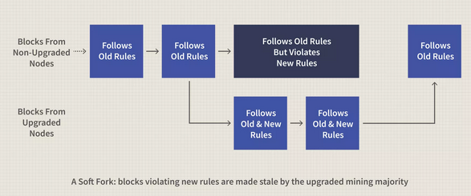
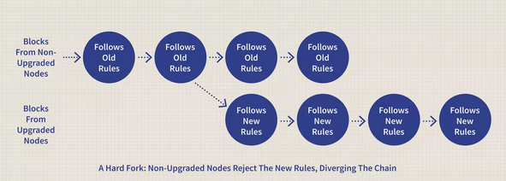
Forks

Slide 5
Major Ethereum Forks
Ethereum July 30, 2015
Vitalik Buterin, founder of Ethereum, and his team finished the 9th and final proof of concept known as Olympic in May 2015. The Ethereum blockchain, also known as Frontier, went live shortly after, on July 30, 2015.
Ice Age Sep 8, 2015
Also known as “Frontier Thawing”, this was the first (unplanned) fork of the Ethereum blockchain, providing security and speed updates to the network.
Homestead Mar 15, 2016
Homestead is widely considered Phase 2 of Ethereum’s development evolution. This rollout included three critical updates to Ethereum: the removal of centralization on the network, enabling users to hold and transact with ETH, and to write and deploy smart contracts.

Slide 6
Major Ethereum Forks
The DAO July 20, 2016
The Decentralized Autonomous Organization (DAO) event was the most contentious event in Ethereum’s short history. The DAO team raised US$150 million through a 2016 token sale—but an unknown hacker stole US$50 million in ether (ETH), prompting the developer community to hard fork in order to recover the stolen funds.
Ethereum Classic
Widely regarded as the only Ethereum fork of any significance, this hard fork was based on the controversial DAO event. The original chain became known as Ethereum Classic, and the new chain moved forward as the main Ethereum chain.
Metropolis-Byzantium Oct 12, 2017
Regarded as the third phase of Ethereum’s evolution, the Metropolis-Byzantium soft fork functioned more like an operating system upgrade, rather than a full split.

Slide 7
Major Ethereum Forks
Metropolis-Constantinople Feb 28, 2019
This hard fork occurred concurrently with the St. Petersburg update. Important changes included closing a major security loophole that could have allowed hackers to easily access users’ funds.
Atlantis Sep 29 2019
This September 2019 hard fork event required all software users to upgrade their clients in order to stay with the current network. Enhancements included better security, stability, and network performance for higher volumes of traffic.
Istanbul - December 2019
Muir Glacier - January 2020
ETH 2.0 - A planned fork referred to as Ethereum 2.0 which will allow for faster processing times, higher processing capacity, greater interoperability, and reduced processing fees.

Slide 8
Soft Fork: EIP Explaination
EIP: Ethereum Improvement Proposal
Eample EIP 155:
https://github.com/ethereum/EIPs/blob/master/EIPS/eip-155.md
Before EIP 155: nonce, gasPrice, gasLimit, to, value, data
After EIP 155: Add ChainId Parameter
One can easily observe that the transaction is not chain specific, meaning if you are on a private Ethereum network, someone could take your transaction on that network and broadcast it to the public network and it will be valid

Slide 9
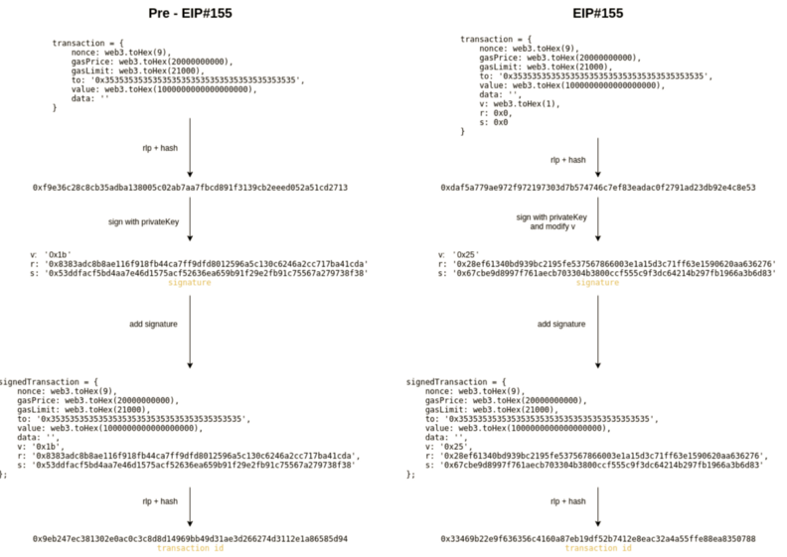
Soft Fork: EIP Explaination

Slide 10
EIP Demo
var Web3 = require('web3');
var web3 = new Web3(new Web3.providers.HttpProvider('https://mainnet.infura.io/'));
console.log(web3.eth.getTransaction('0x4b420c328f11bbf4cc0043af7bd8b170026e97ef4261e93354bf080c2d04ea6d').v);
//0x26
console.log(web3.eth.getTransaction('0x79fbfd4daa09f7947595f6c1e3d8e78b4032cf64d105292b10f61ebb067d2bcf').v);
//0x1b

